Slide 1
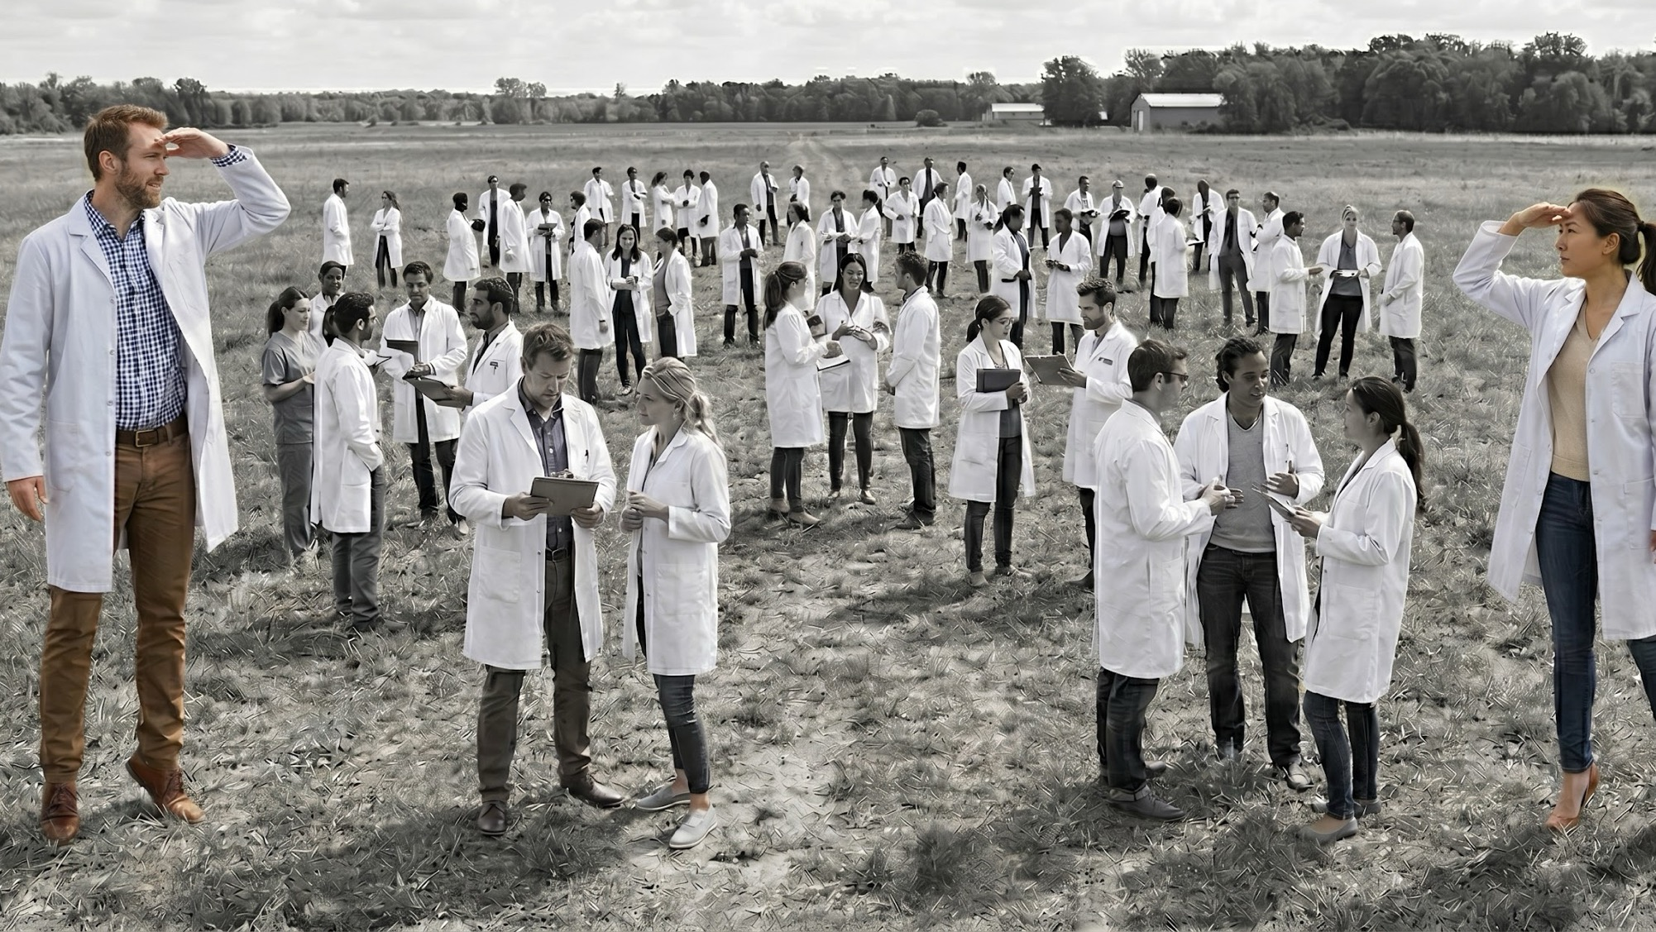
Finding collaborators through enclaved Me-agent Communication
April 23, 2026

Slide 2
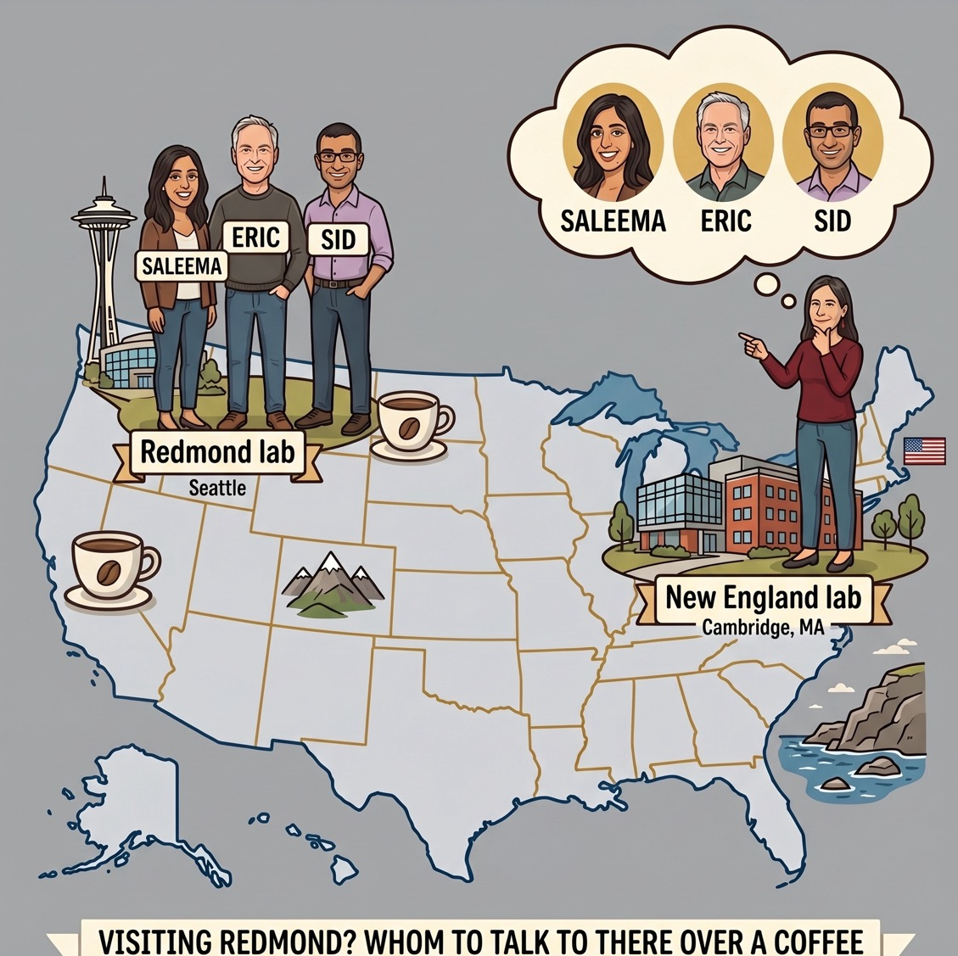
Finding a Needle in a Haystack
Nicole is planning a visit to Redmond. She doesn’t know anyone there.
Whom should she ask out for a coffee?

Slide 3
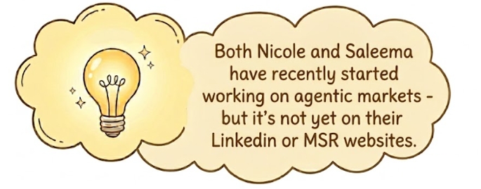
Finding a Needle in a Haystack
Nicole is planning a visit to Redmond. She doesn’t know anyone there.
Whom should she talk to over a coffee?

Slide 4
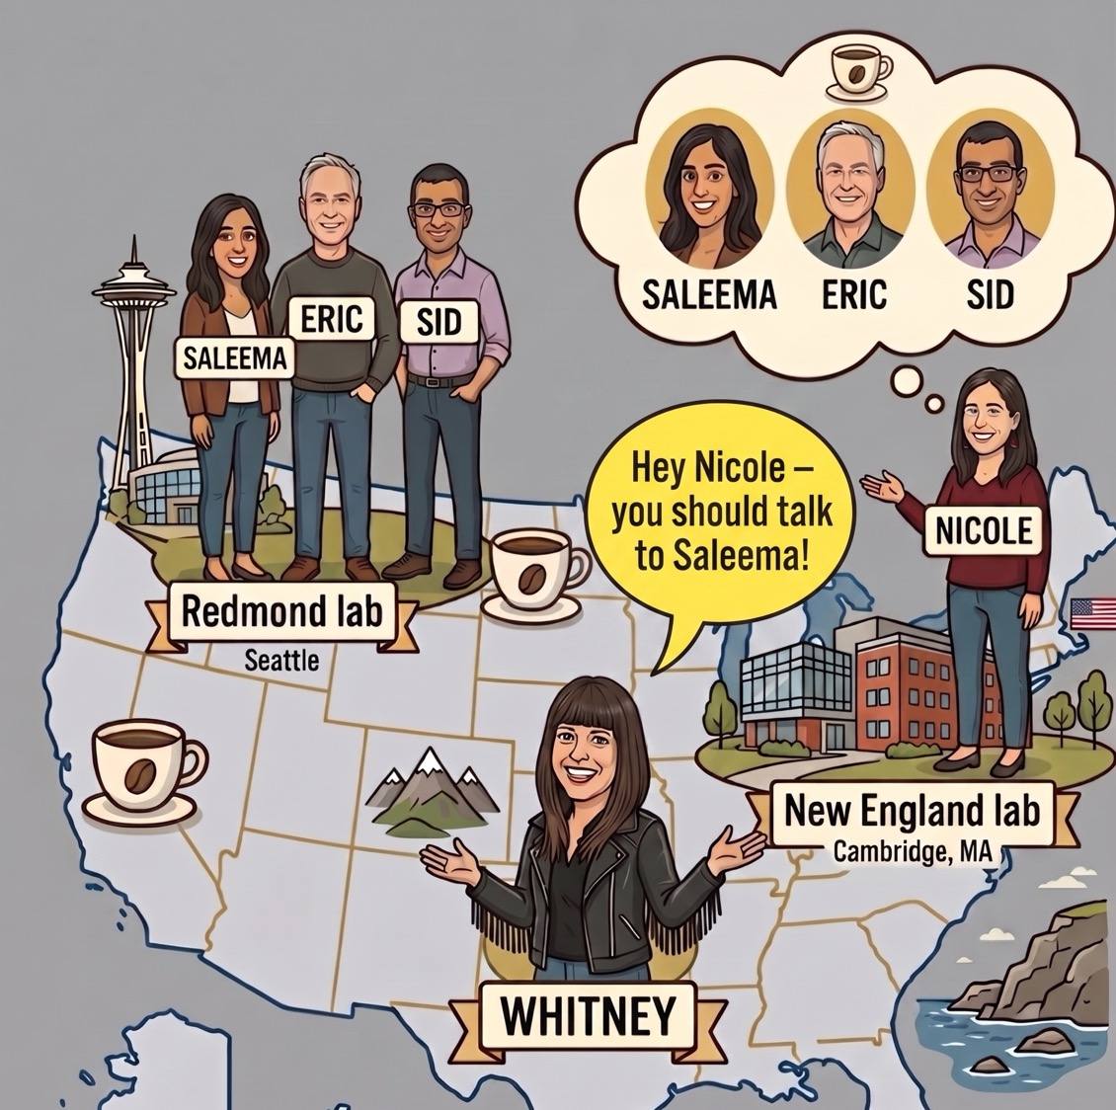
Matchmakers
Nicole might ask “Whitney”, the matchmaker.
Whitney knows both Nicole’s and Saleema’s recent work and can suggest a connection.

Slide 5
What if there aren’t enough Whitneys?

Slide 6
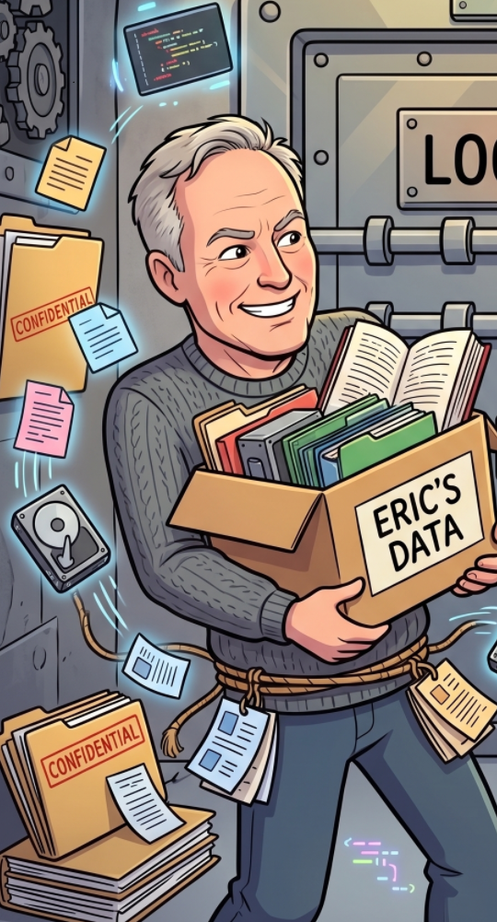
Assume that Eric’s me-agent knows *everything* about Eric (not just his public data).

Slide 7
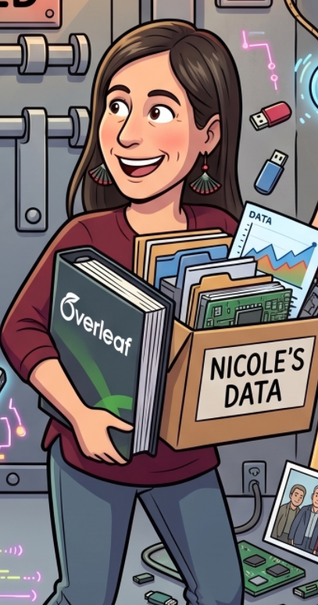
Assume that Eric’s me-agent knows *everything* about Eric (not just his public data).
Assume that Nicole’s me-agent knows *everything* about Nicole (not just her public data).

Slide 8
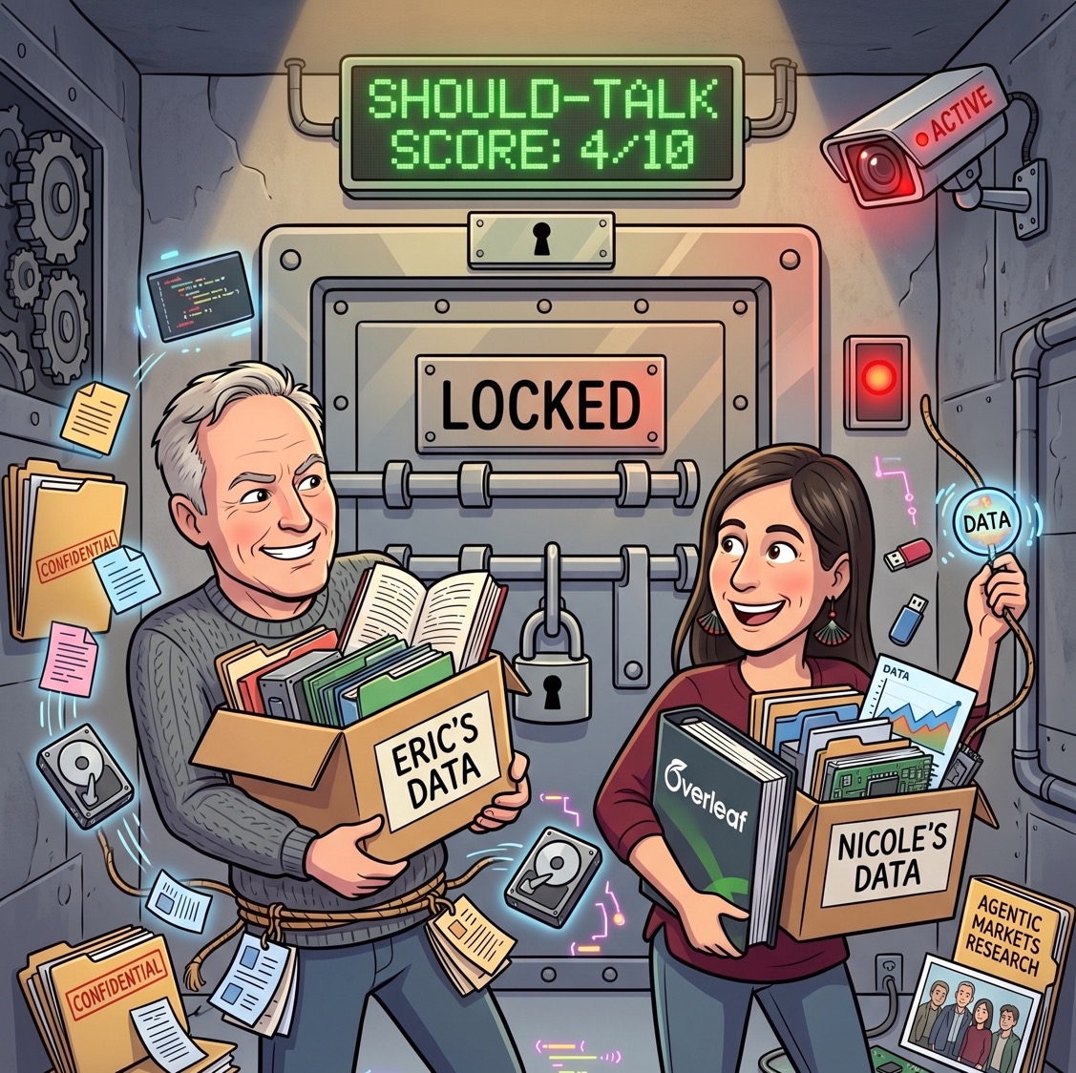
Let’s have Eric’s and Nicole’s me-agents talk directly and figure out a “should-talk” score in an enclave.

Slide 9
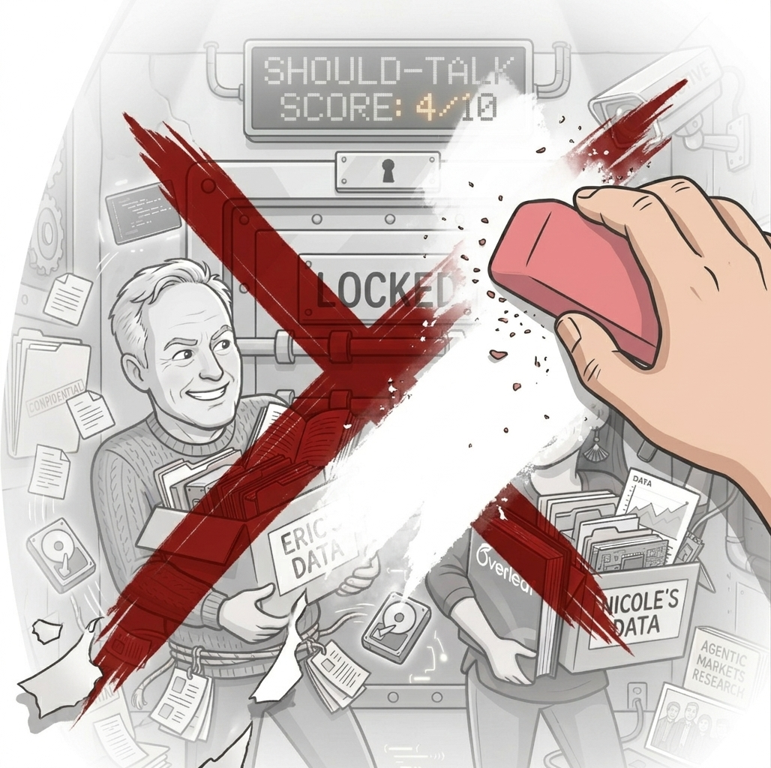
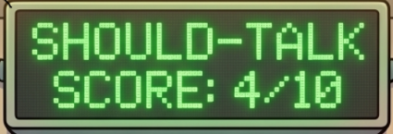

The only data that comes out of the enclave is the should-talk score.

Slide 10
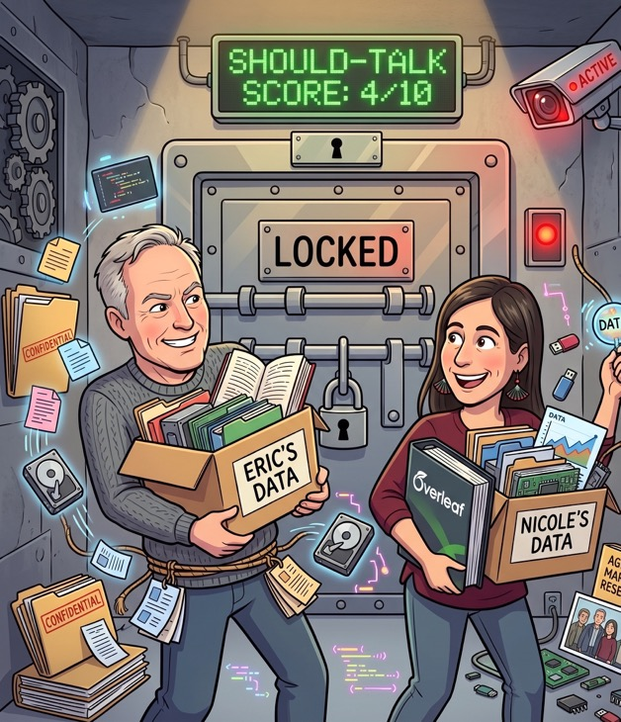
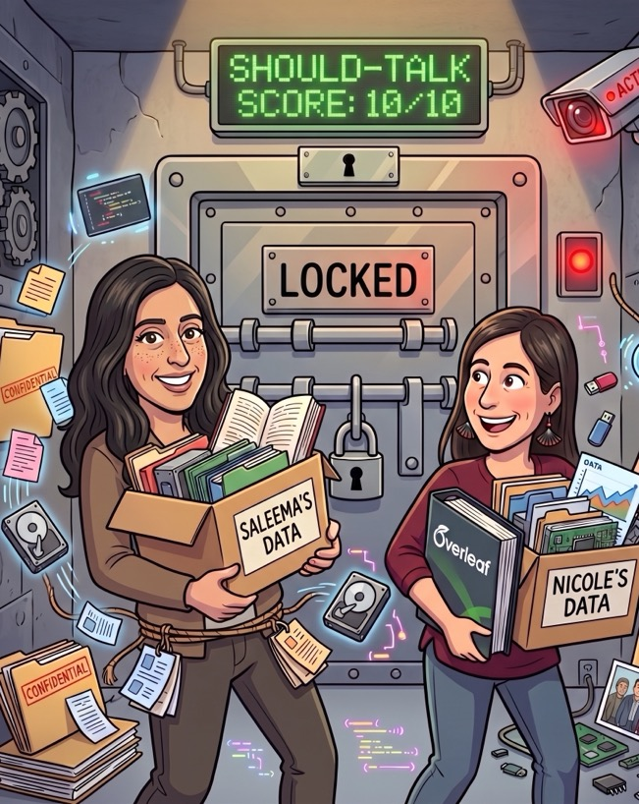
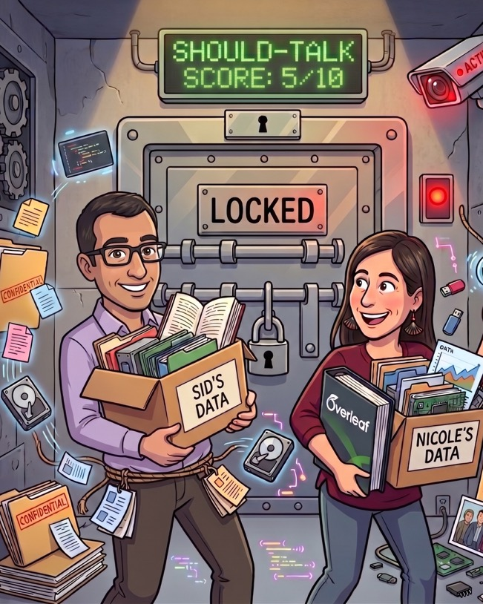
Let’s match Nicole’s me-agent with everyone’s me-agent in Redmond.

Slide 11
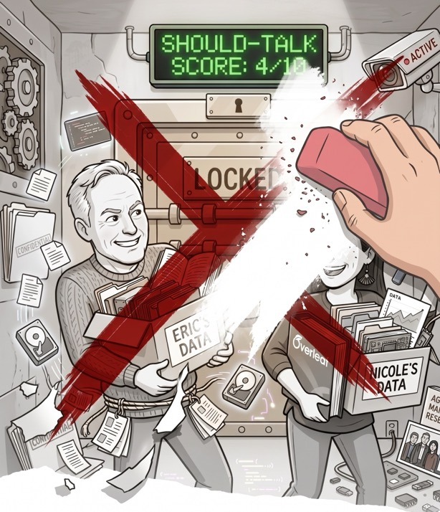

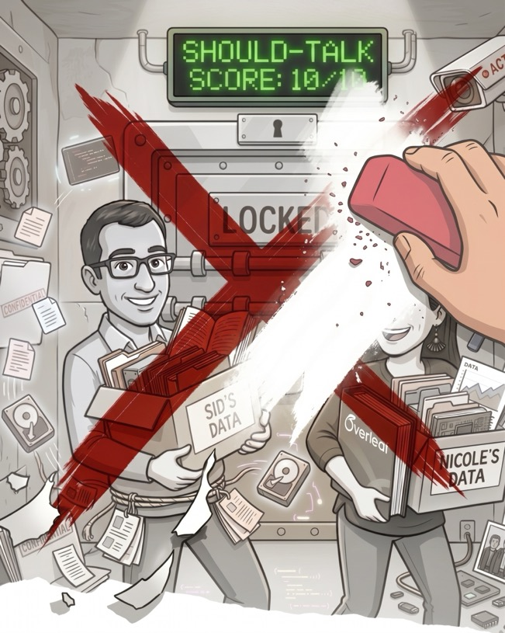

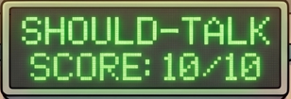
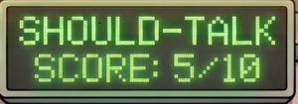
The enclaves produce three scores.

Slide 12
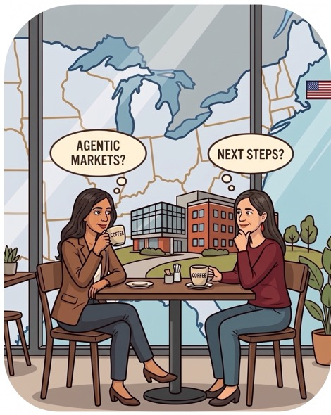
Nicole should ask Saleema for a coffee in the real world.

Slide 13
Demo
https://projectmeld.microsoft.com

Slide 14
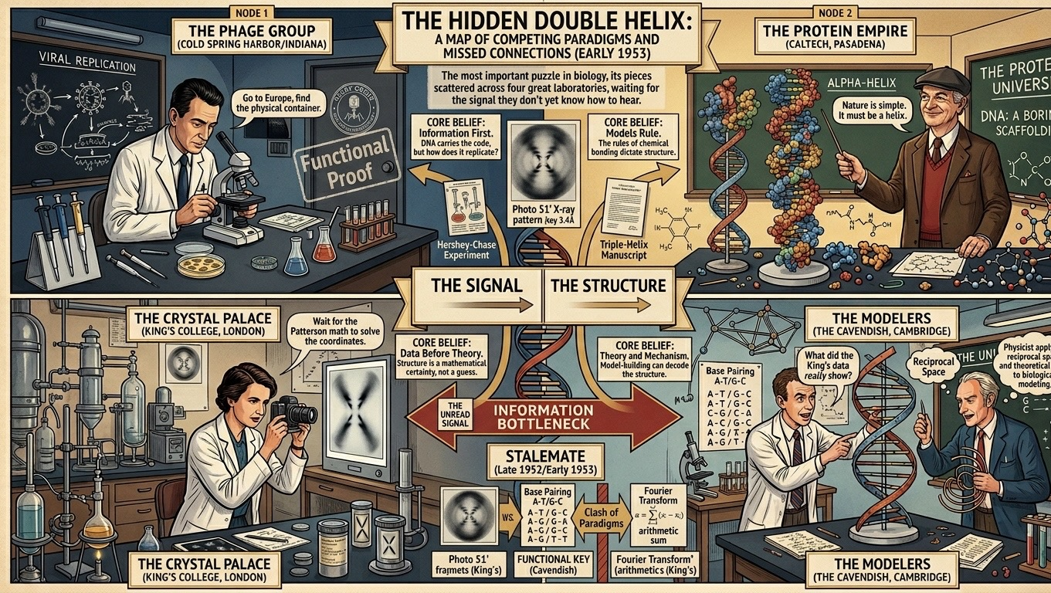
Demo setting: 4 Great DNA labs in early 1950s

Slide 15
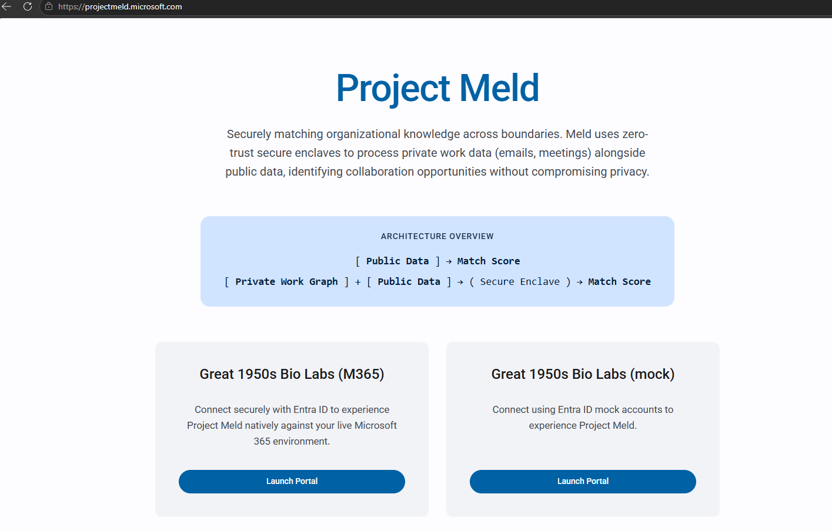
PW: MsrRocks1234

Slide 16
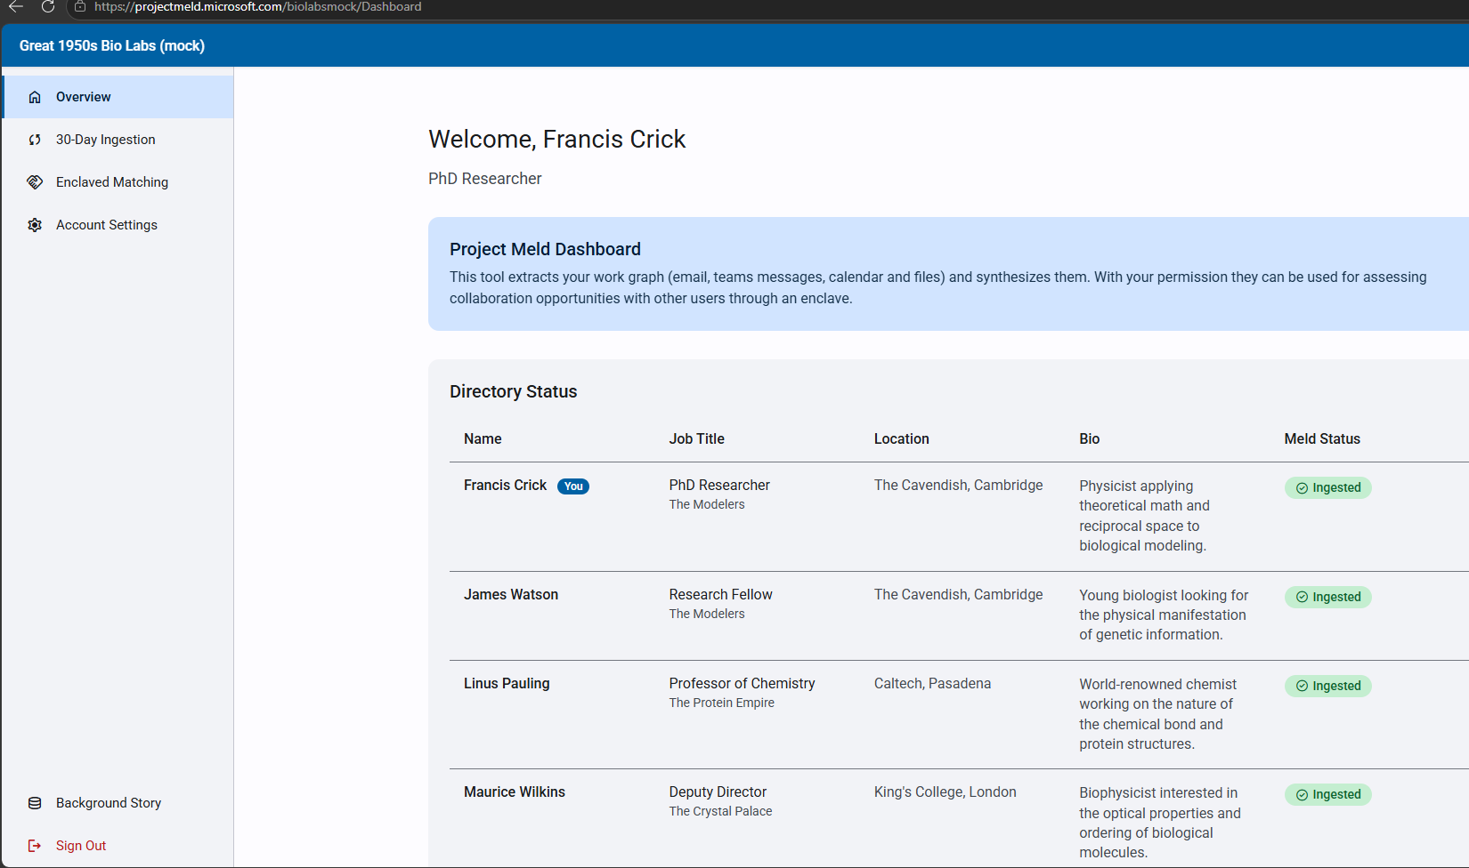
List of signed-up researchers

Slide 17
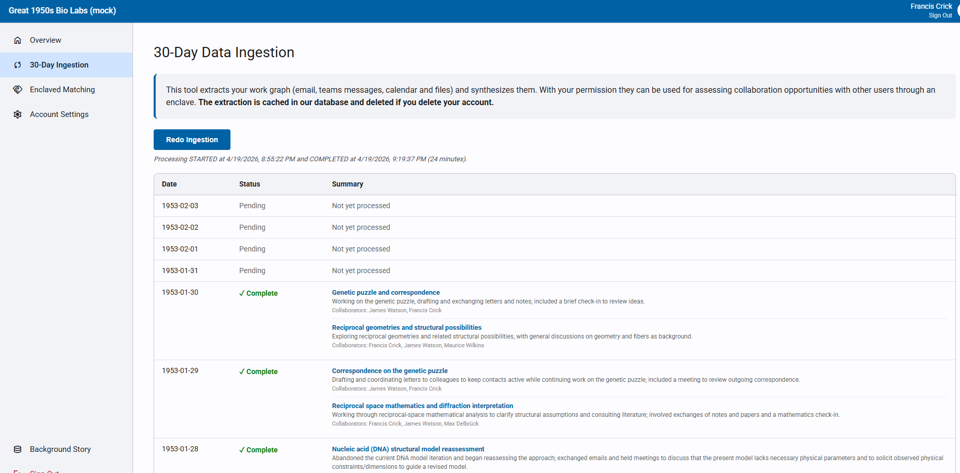
Ingest Microsoft graph data (OneDrive, Teams, Outlook, Calendar) to create me-agent with private data.

Slide 18
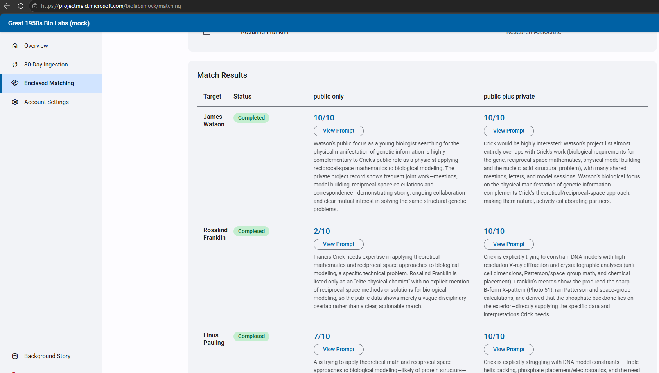
Enclaved matches reveal scores.
Private data beats matching on just public data!

